Slide 1
Danceability
Breaking Down the Vague Concept
By: Ivan Martinez-Kay, Sandy Ge, and Daniel Nickas

Slide 2
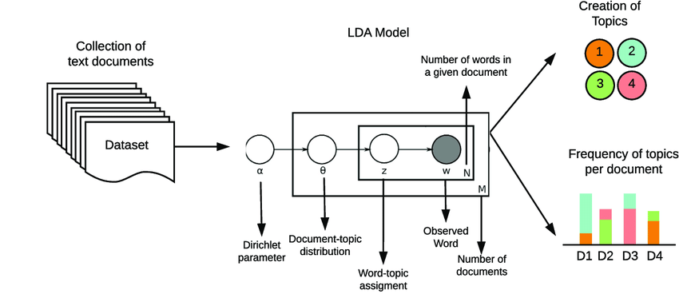
Data set: Guiding to Research Questions
Music is a universal medium of communication
Music data is incredibly relevant (Spotify, Apple Music, YouTube etc…)
latent dirichlet allocation (LDA)
Notes:
Looking for a data set, we came across a publicly available Spotify derived data set on Kaggle. We found it fascinating due to its wide variety of genres and songs as well as its scoring of qualitative characteristics.
How this data is derived can be explained by LDA which is probabilistic model used to find latent semantic topics in collections of texts such as lyrics. The main takeaway is the importance of the ability to properly (and consistently) categorize (via assignment of numerical values) to effectively study and observe correlations between song quality, genre, and the context in which it is used. These song qualities and characteristics are assigned values 0-1 using a cosine based equation that considers the most most widely characteristics or quality and compares it to the rarest.

Slide 3
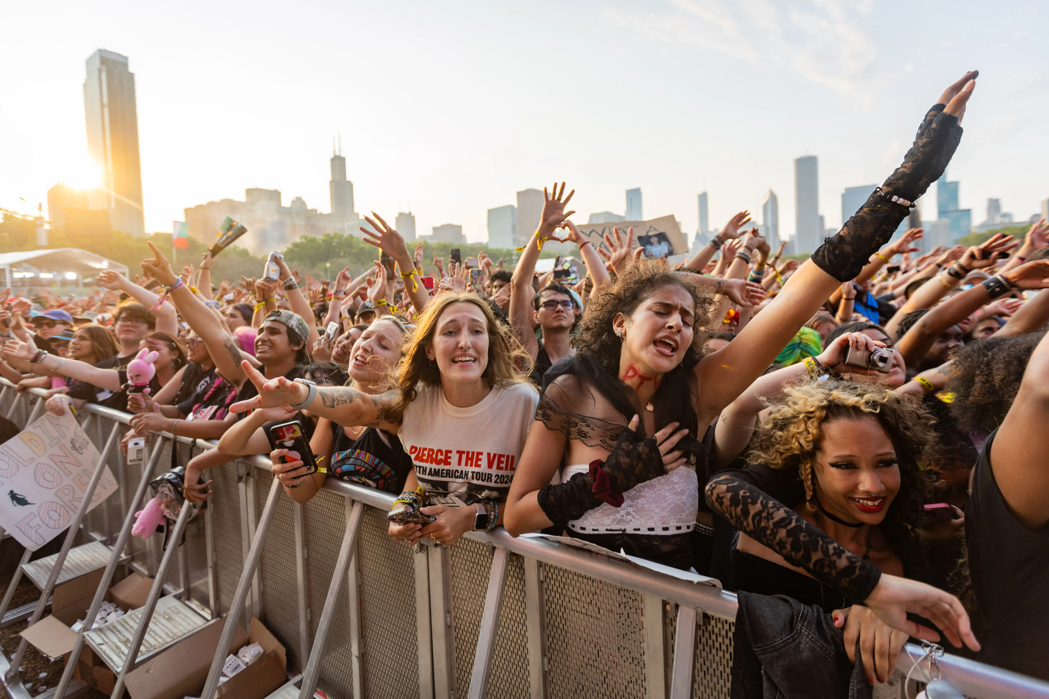
Background behind Data collection
Why does music make us feel a certain way? Can we show this with data?
Musical Sentiment
What genres are most danceable?
Why?
Observing song a few song characteristics: Instrumentation and loudness, or “feel”
Notes:
We wanted to see what we could find about the relationship between songs and why we feel about them the way we do. Though a broad and nuanced topic we made it more specific by focusing on a significant musical quality: danceability.
In a paper that references this data set, danceability is defined as: how suitable a track is for dancing based on a combination of musical elements including tempo, rhythm stability, beat strength, and overall regularity
With this we wanted to see if we could find connections between danceability and other musical qualities
Why are certain types of music more danceable than others?
Why does this matter?
This is part of a larger idea that considers the usefulness of music research in this context of categorization.

Slide 4
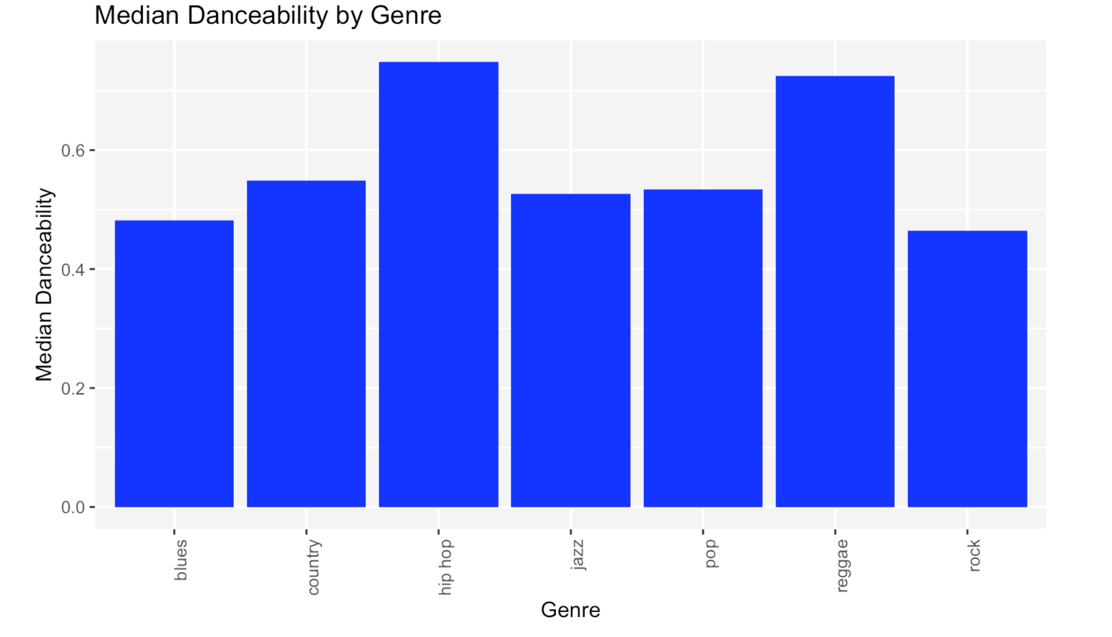
Filtering Our Data
We started with a general analysis of danceability by genre to identify trends.
Notes:
By singling out the median Danceability score of each genre we gain insight.
-We can clearly distinguish that hip hop and reggae are our leaders so far.
-Blues appears to be the least danceable by median score.

Slide 5
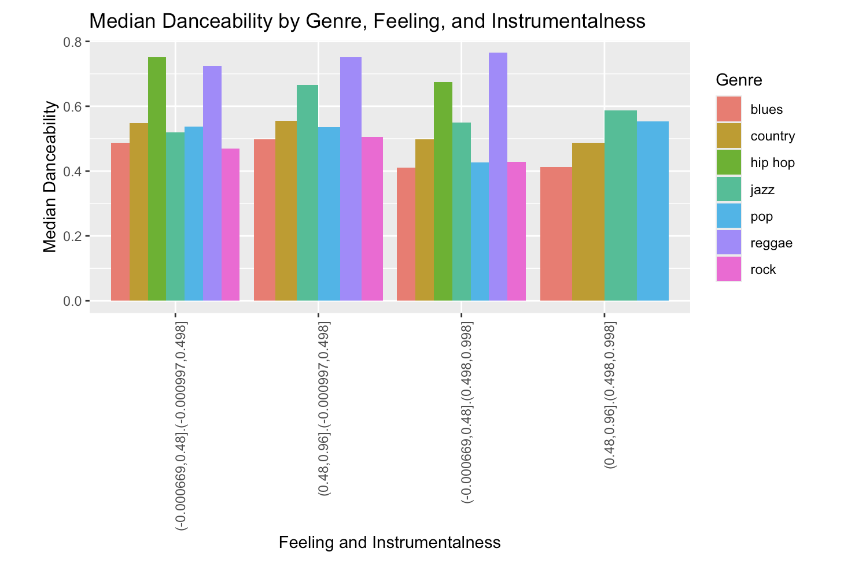
Filtering Data
A synthesis chart of instrumentality and feeling shows:
That lower instrumentality and feeling were related to danceability
Hip hop and reggae were consistently lower scorers. Rock was an outlier.

Slide 6
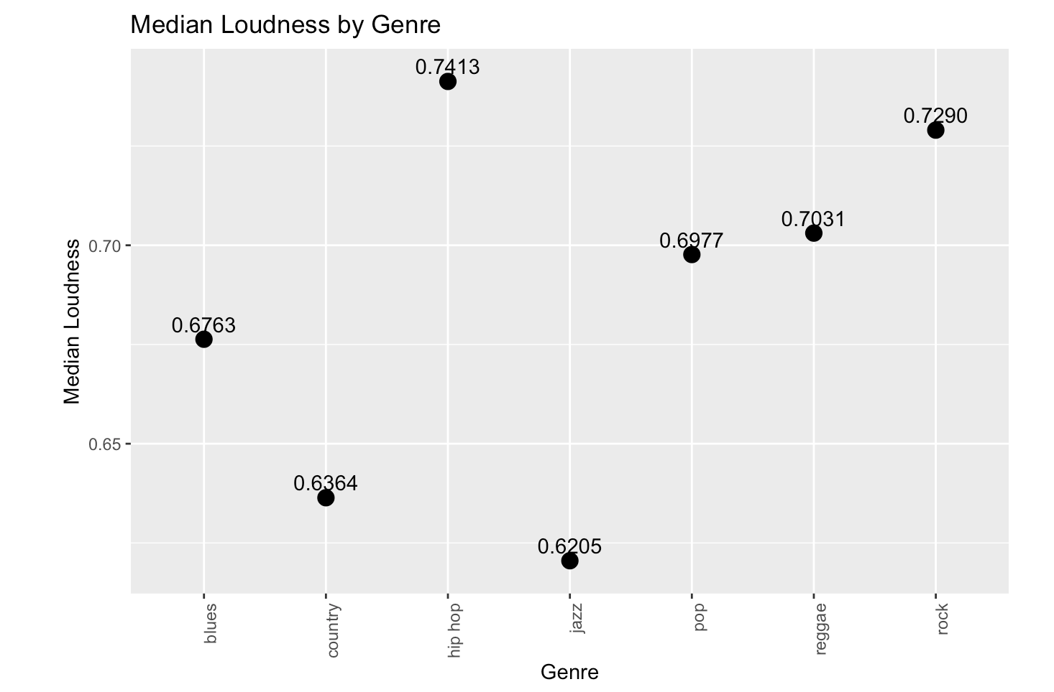
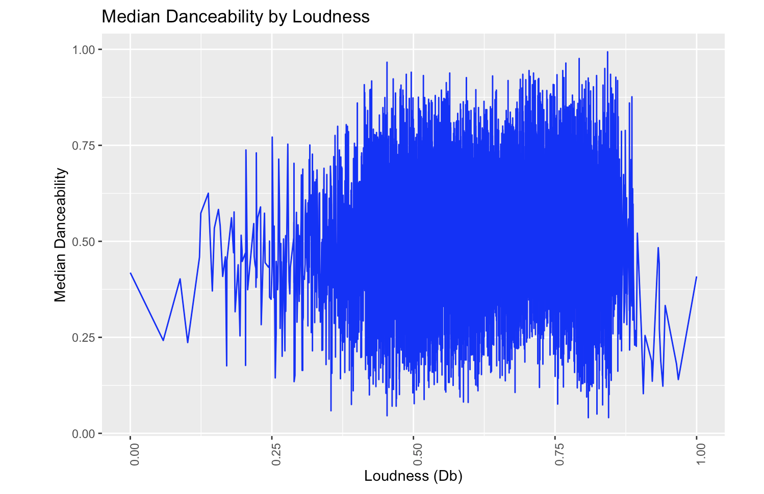
Filtering Our Data
We further filter the data…
Our highest scorers appear closest to our second peak.
None of the genres appear remotely close to the first peak.
Loudness is proportional to danceability.

Slide 7
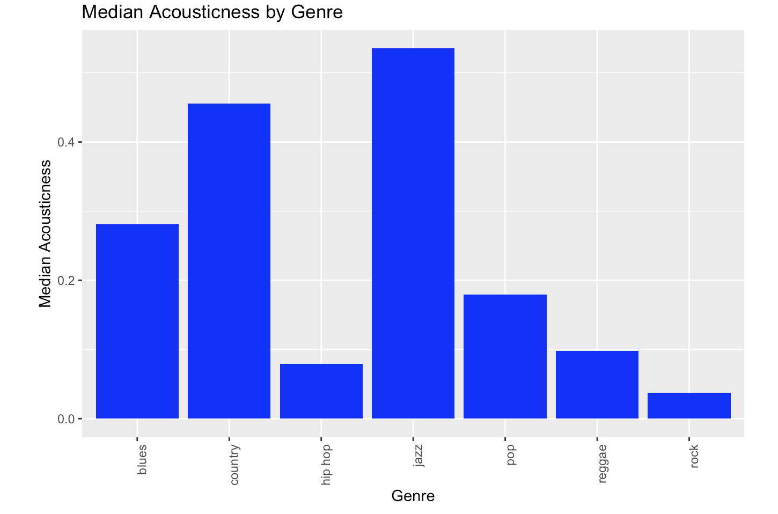
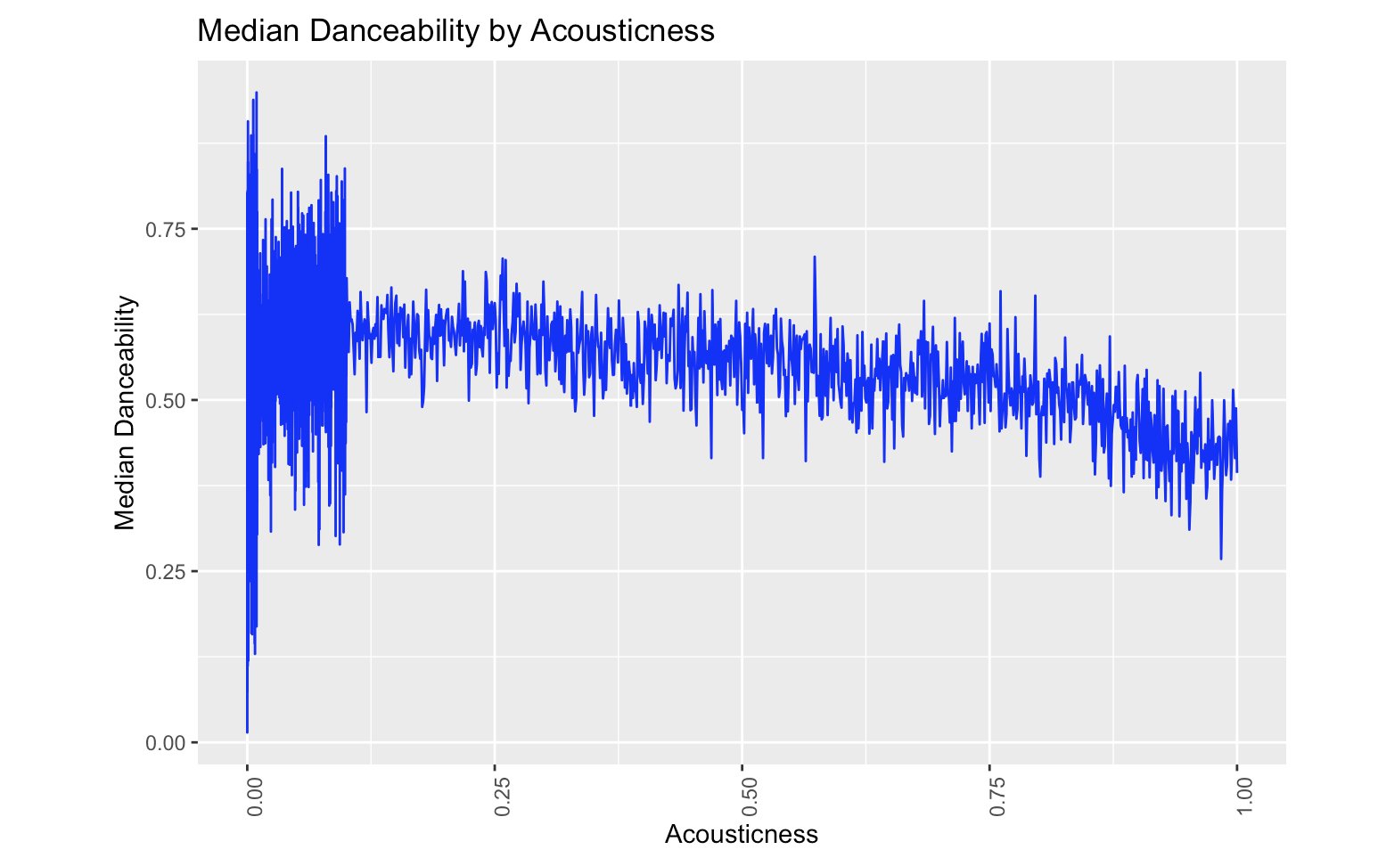
Filtering Our Data
We further filter the data…
We find that acousticness is inversely proportional to danceability.
There is a much higher concentration of peaks near the origin.
Our most danceable genres so far are closest to the origin, with rock being the outlier once again

Slide 8
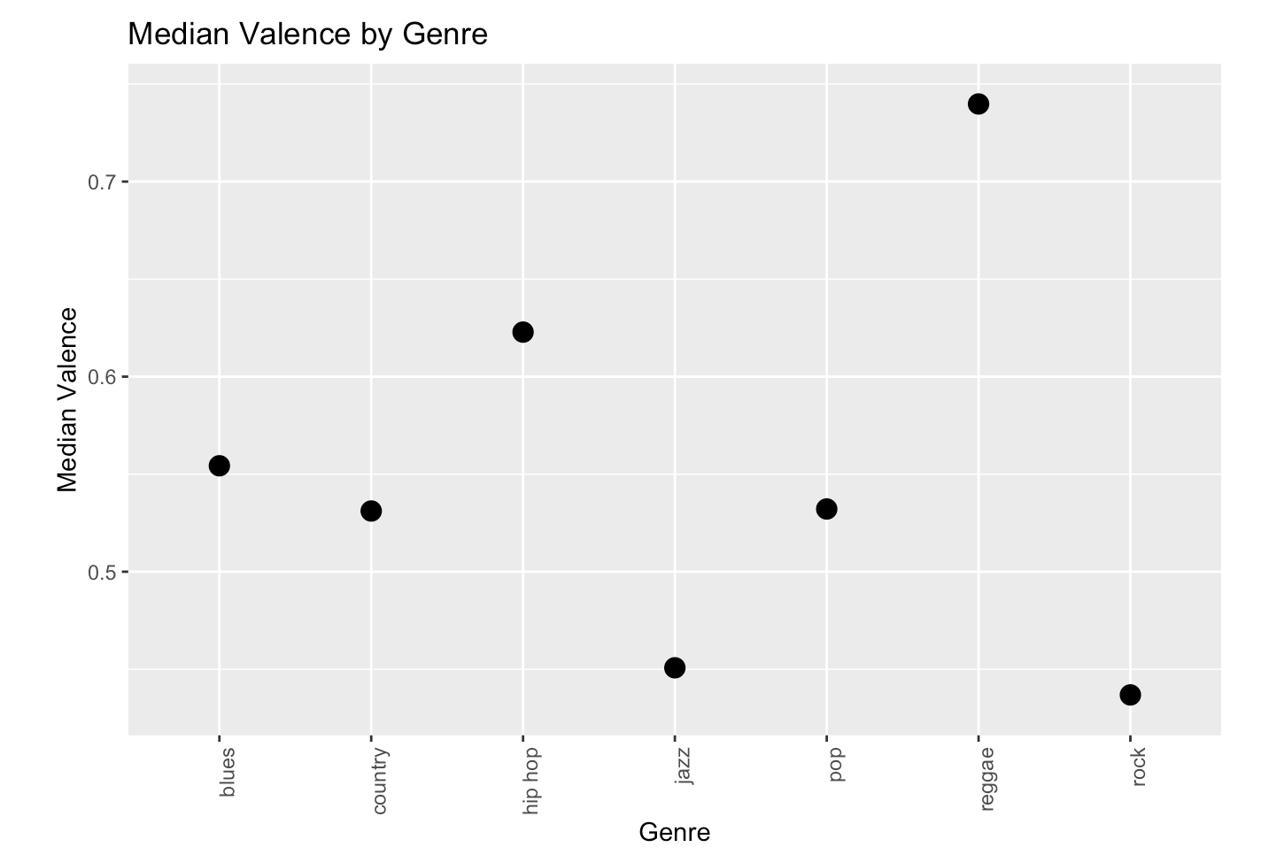
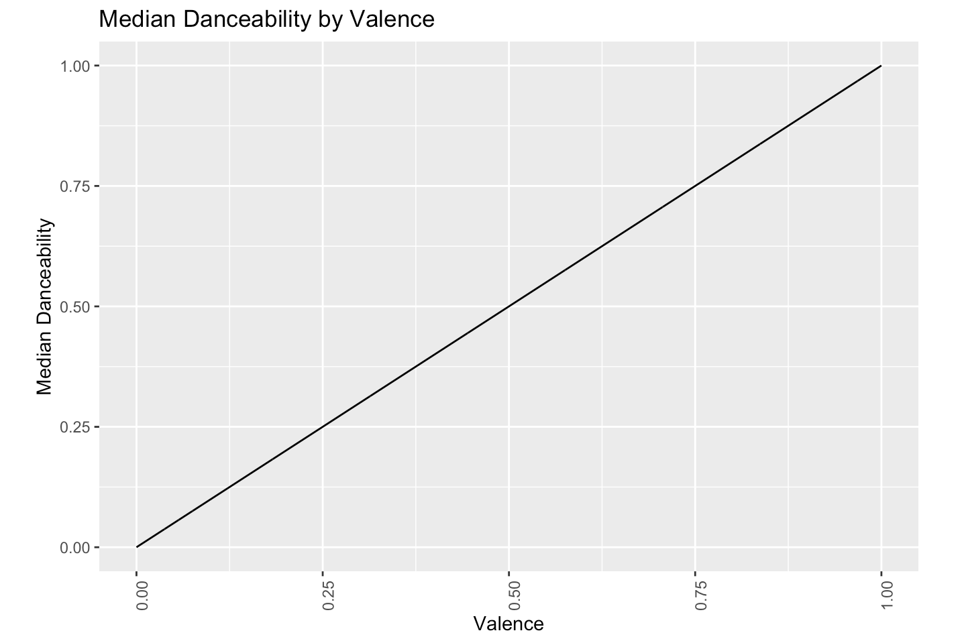
Filtering Our Data
Let’s eliminate the outlier…
We find that valence linearly and directly proportional to danceability.
Hip hop and reggae have the highest valence. Rock’s is staggeringly low.
This shows that rock lacks certain danceable characteristics.

Slide 9
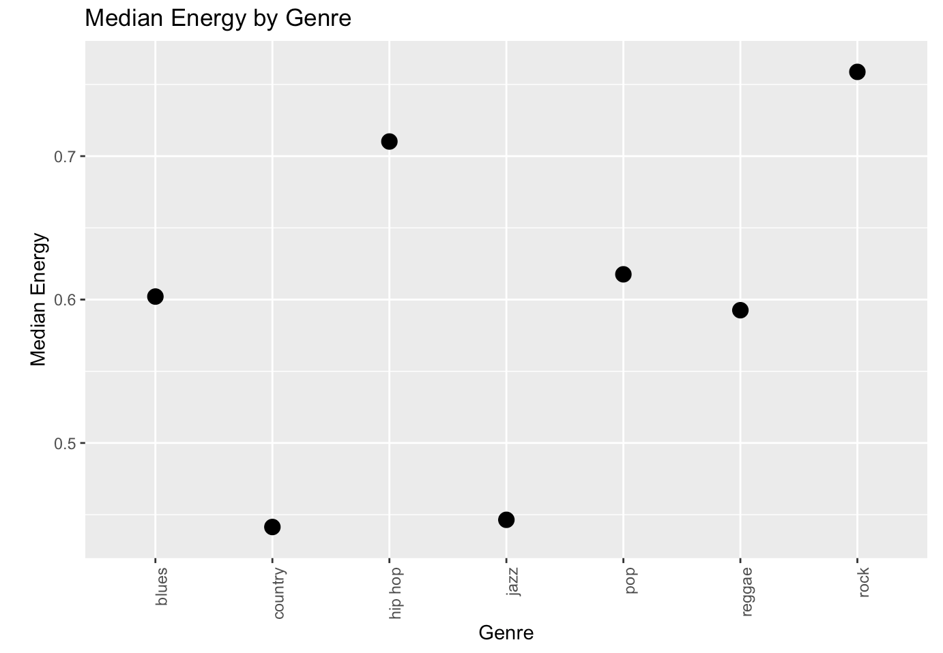
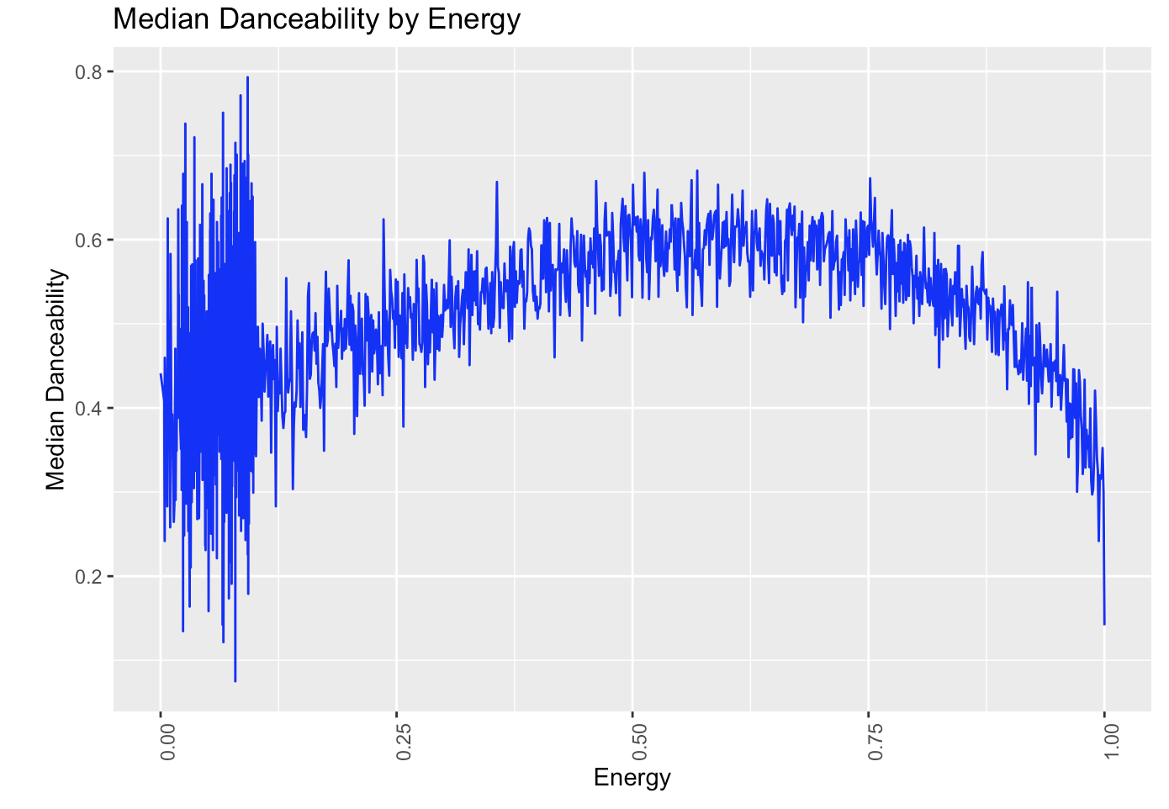
Filtering Our Data
Finally let’s look at energy…
We find that our high scorers are consistently higher near the middle.
Rock finds itself with a high energy score, but if you notice, the graph has a stark drop off at the higher scores.
We have eliminated our outlier.

Slide 10
Here are the elements relating to danceability
High Instrumentality, Acousticness, and Energy = Low Danceability
Acoustic qualities are directly correlated with instrumentation
Blues and jazz are great examples
This suggests lyrical music is highly danceable
High Loudness and Valence = High Danceability
We observe this in relatively linear relationships
Happy Music = High Danceability
Hip hop and reggae have high valence suggesting a euphoric effect
Notes:
Instrumentality: A high value describes whether a track contains fewer vocals;
Loudness: The average loudness in decibels (dB) across the entire track;
Valence: High values means that the track is more happy, euphoric (sad,angry)
Hip hop and reggae have the highest media danceability.
They are also amongst the lowest in instrumentality and score in the lower bin of feeling index,
Hip hop and reggae are amongst the loudest. Acousticness directly correlates to instrumentality. Higher acousticness points to a lower danceability…. This points out that hip hop and reggae are much more lyrical genres, suggesting that lyrical music is more danceable in general.
Furthermore we find that a higher Valence (euphoric presence) is present in hip hop and reggae, suggesting that these two genres are typically more happy

Slide 11
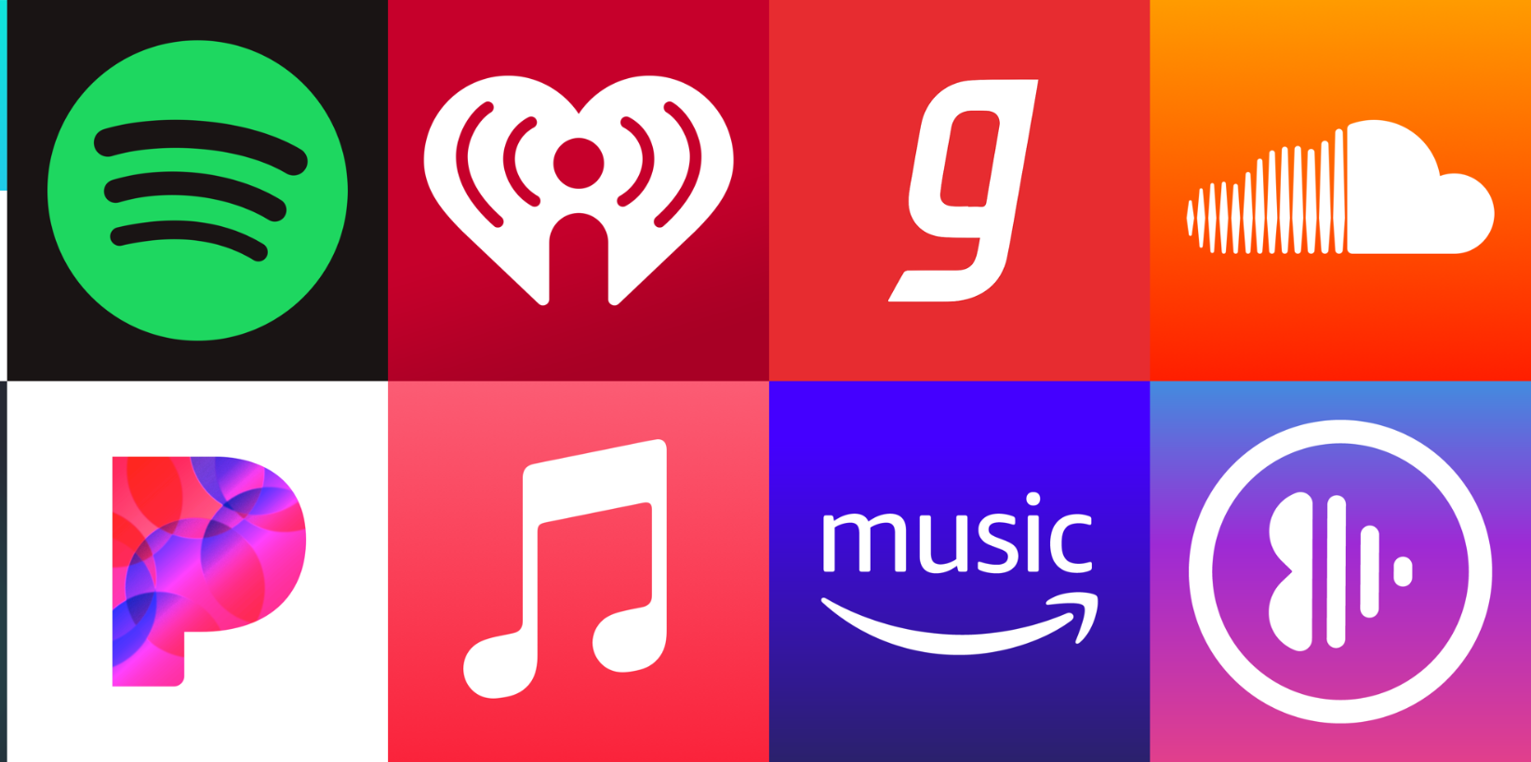
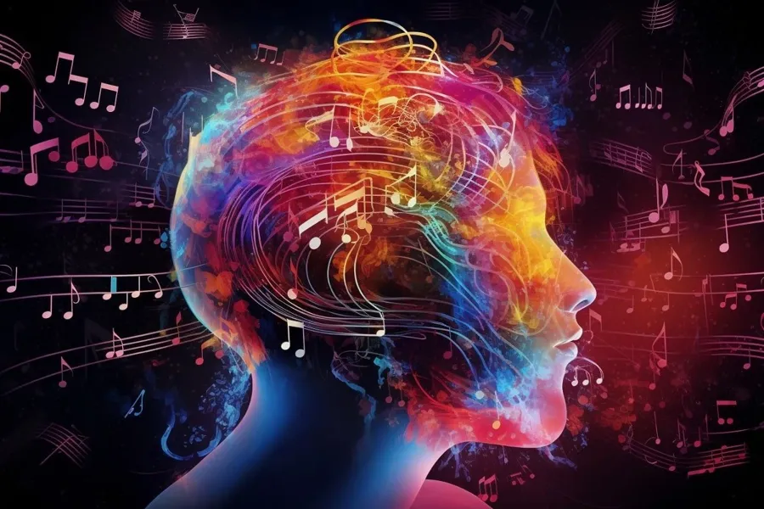
Application of Our Findings
Find music for dancing
Music recommendations
Think about how much you depend on Spotify, Apple Music, YouTube, etc… to recommend you good music!
Emotional connection
Notes:
Musical sentiment Listener trends and why we connect certain genres with specific themes that extend beyond what we hear.

Slide 12
Works Cited:
Kim, Y. E., Schmidt, E. M., Migneco, R., Morton, B. G., Richardson, P., Scott, J., Speck, J. A., & Turnbull, D. (n.d.). MUSIC EMOTION RECOGNITION: A STATE OF THE ART REVIEW. 11th International Society for Music Information Retrieval Conference (ISMIR 2010). https://archives.ismir.net/ismir2010/paper/000045.pdf
Liew, K., Koh, A. H., Fram, N. R., Brown, C. M., Lee, L. N., Hennequin, R., ... & Uchida, Y. (2023). Groovin’to the cultural beat: Preferences for danceable music represent cultural affordances for high-arousal negative emotions. Psychology of Aesthetics, Creativity, and the Arts.
Misael, L., Forster, C., Fontelles, E., Sampaio, V., Franca, M. (2020). Temporal Analysis and Visualisation of Music. Encontro Nacional De Inteligência Artificial e Computacional (ENIAC).
Song, H. (2021). Tracking the Emotion of Music Across the Covid-19 Pandemic.
Web API Reference | Spotify for Developers. (2022). https://developer.spotify.com/documentation/web-api/reference/get-audio-features

